Slide 1
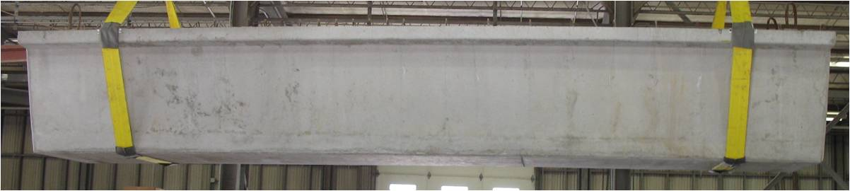
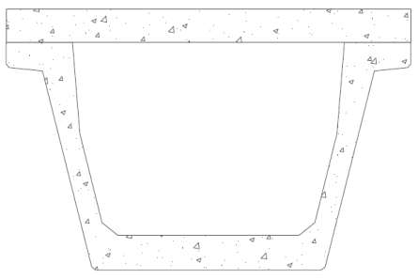
Bursting and Shear
in Texas U-Beams
Catherine Hovell
Alejandro Avendaño
Dave Dunkman
Andy Moore
Oguzhan Bayrak
James Jirsa
Dean Van Landuyt
John Holt
Amy Eskridge
Graham Bettis
German Claros

Slide 2
Today’s Objectives
Review:
  Project goals
  Work performed since last meeting
  Tasks planned for the near future
Discuss:
  Strains and cracking at release
  Curing temperatures
  Shear capacity

Slide 3
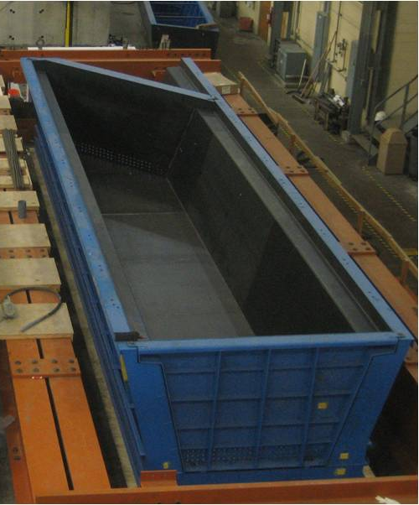
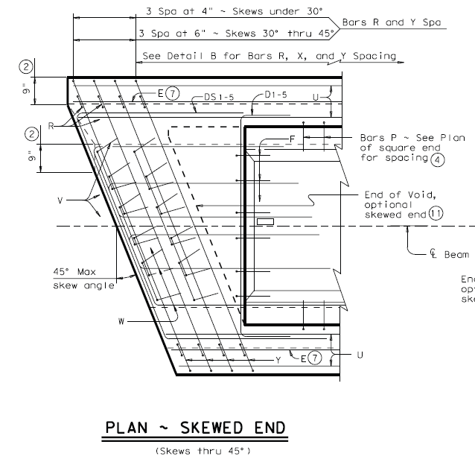
Project Goals
Understand the behavior of the end
regions of U- and box-beams with
skewed ends
  at release
  under shear loads
Simplify the design of the end regions
of these beams
Test the simplified details
  at release
  under shear loads

Slide 4
Project Timeline
2008
2009
October
November
December
January
February
March
April
May
June
July
TxDOT meeting
TxDOT meeting
Beam 1 design, fabrication, and testing
Beam 2 design, fabrication, and testing
Beam 3 design, fabrication, and testing
Beam 4 design, fabrication, and testing
5197 box beam testing, 5831 box beam fabrication and testing
To summarize:
  We have constructed two beams (Beams 1 and 2) and are working on a third (Beam 3)
  We have tested Beams 0, 1, and 2 (Beam 0 fabricated at Bexar)
  We intend to have at least four beams constructed and tested by the end of the summer
  Alejandro will be discussing more on box beams a bit later today

Slide 5
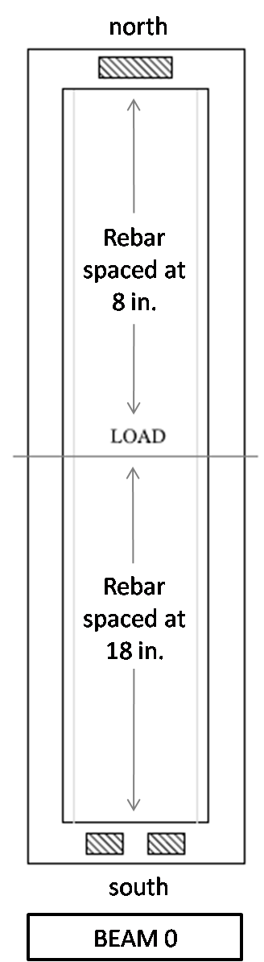
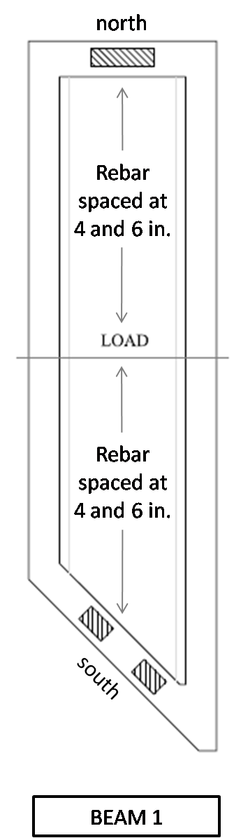
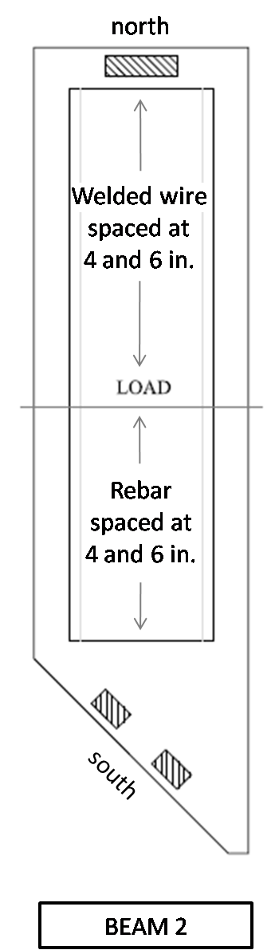
Recent Work Performed
Beam 0 fabricated at Bexar and tested last summer
  Beam 0: straight ends, 18 in.,
  8 in. rebar spacing
Beams 1 and 2 fabricated at FSEL and tested in January and March
  Beam 1: current optional small TxDOT end block detail; all rebar
  Beam 2: current standard TxDOT end block detail; welded wire used for shear reinforcement at square end
BEAM 0
BEAM 1
BEAM 2

Slide 6
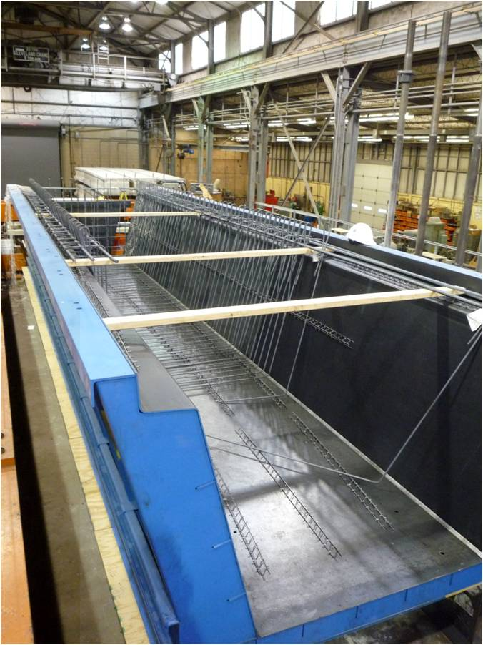
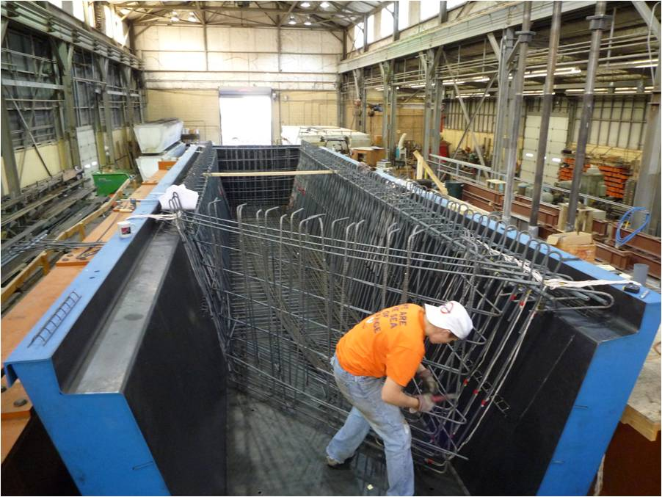
Fabrication Process
Beam 1 under construction
October 2008

Slide 7
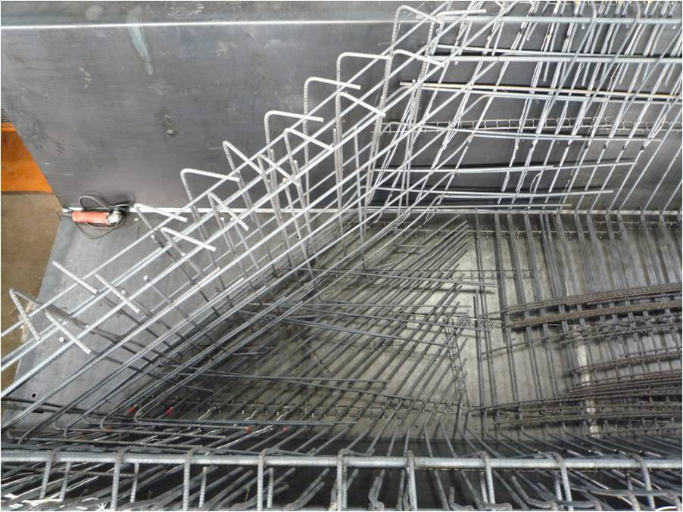
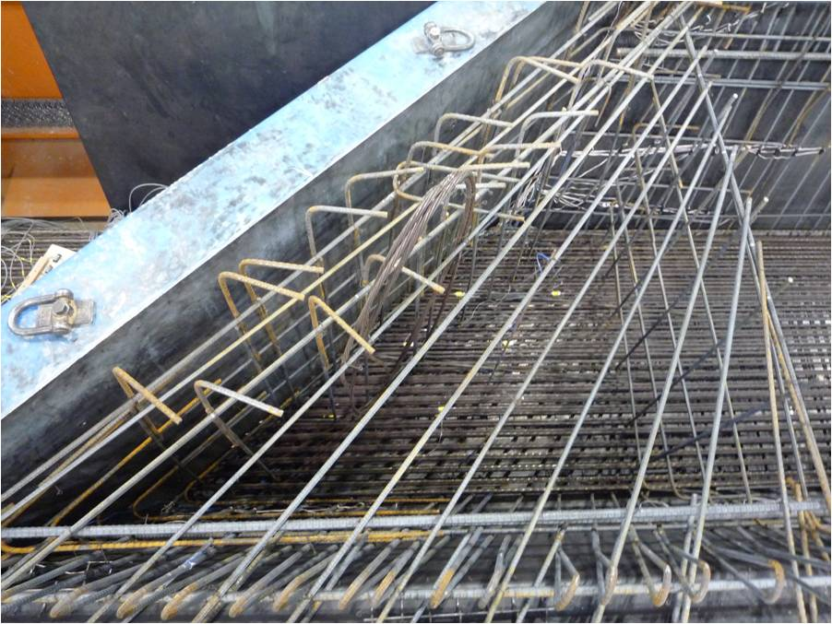
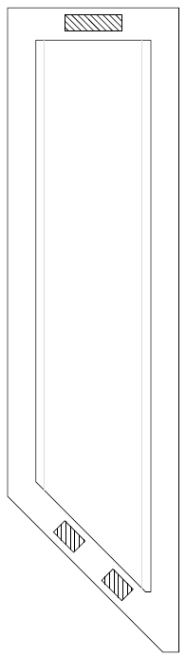
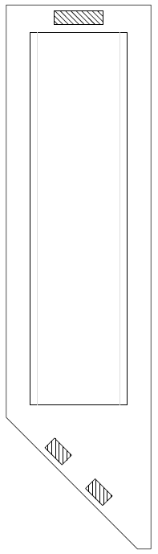
Fabrication Process
Beam 1 skewed end block rebar cage
November 2008
Beam 2 skewed end block rebar cage
February 2009
Beam 1
Beam 2

Slide 8
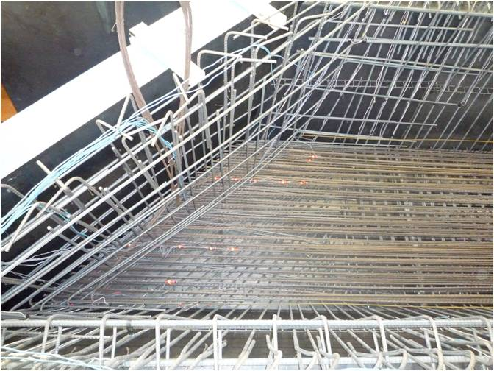
Fabrication Process
Beam 1 skewed end block rebar cage
November 2008
Beam 2 skewed end block rebar cage
February 2009
Beam 1
Beam 2

Slide 9
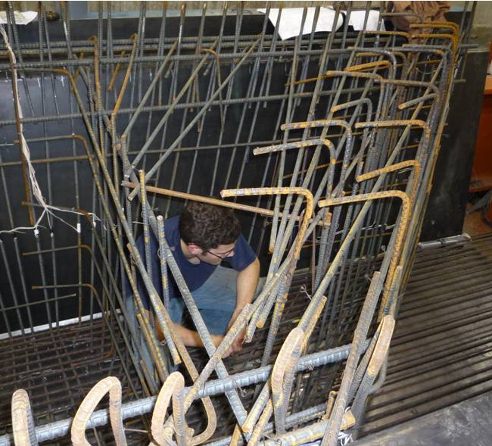
Fabrication Process
Beam 2 skewed end block rebar cage
February 2009
Beam 2

Slide 10
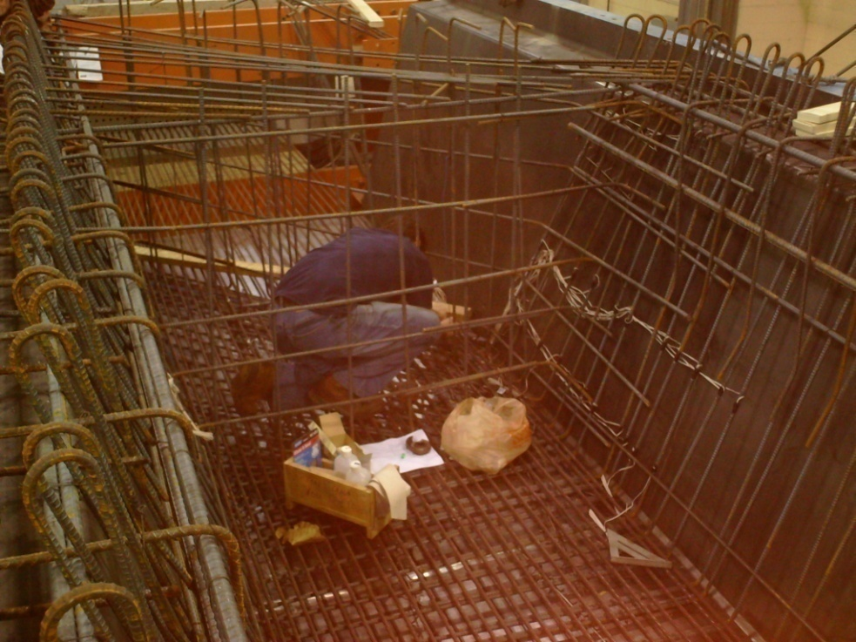
Fabrication Process
Beam 2 skewed end block rebar cage
February 2009
Beam 2

Slide 11
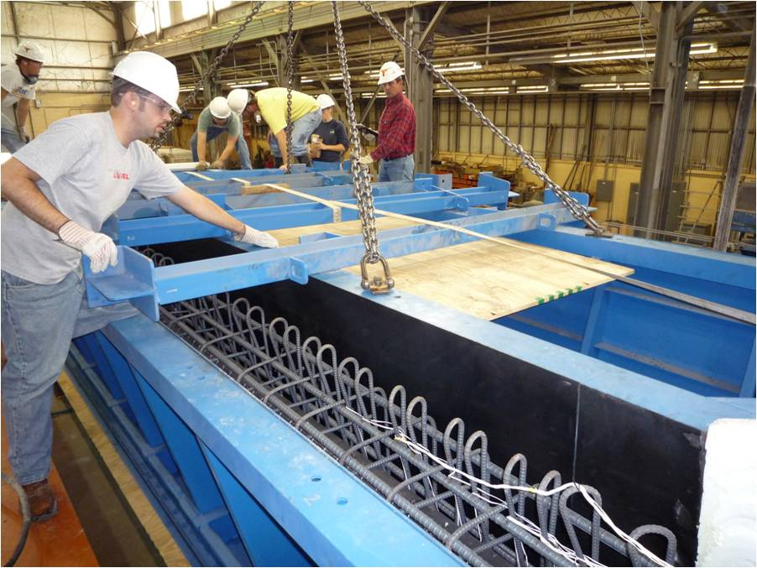
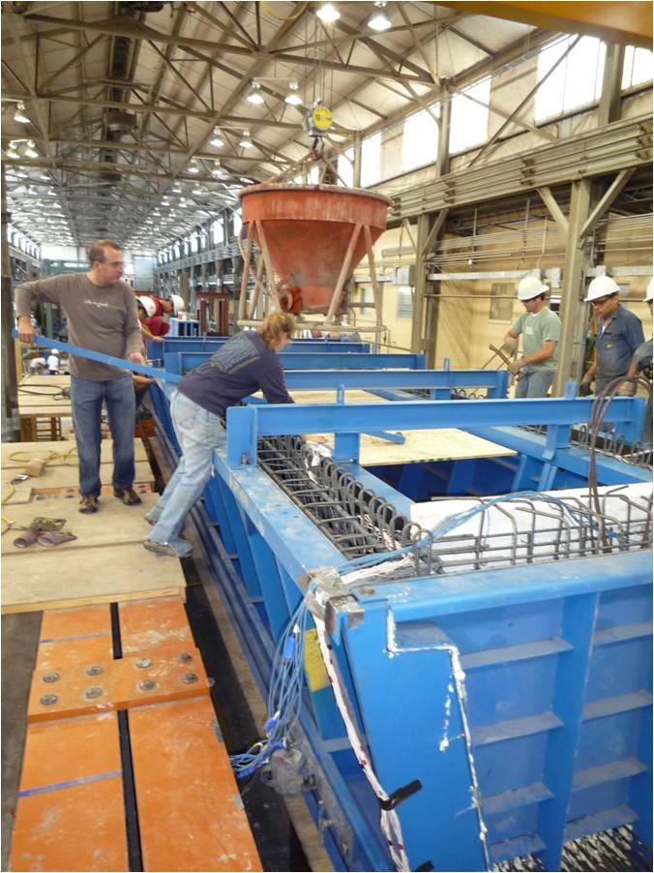
Fabrication Process
Beam 1 on cast day
November 18, 2008

Slide 12
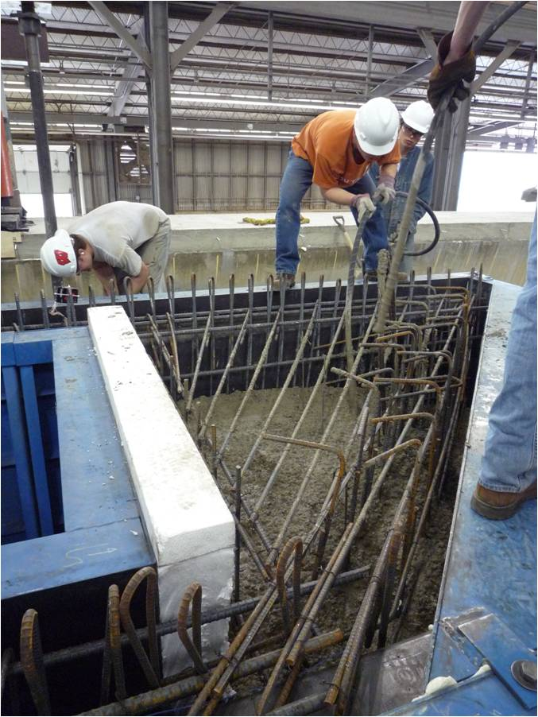
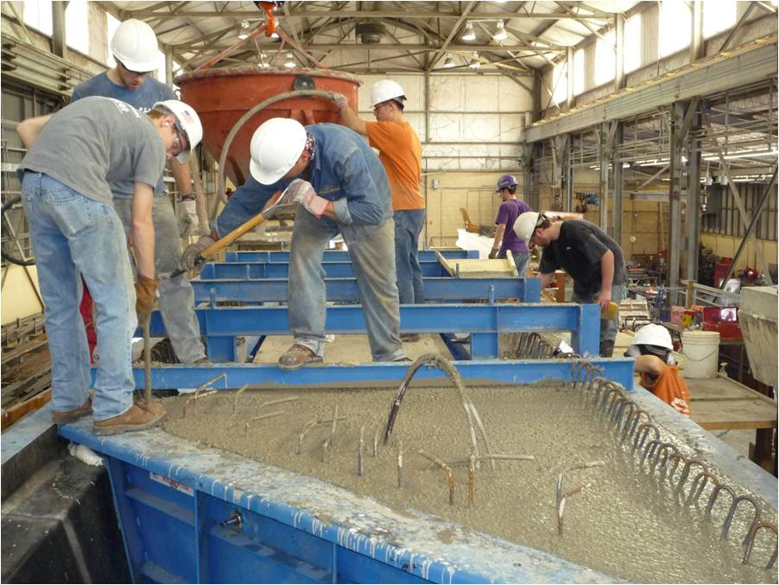
Fabrication Process
Beam 2 on cast day
February 26, 2009

Slide 13
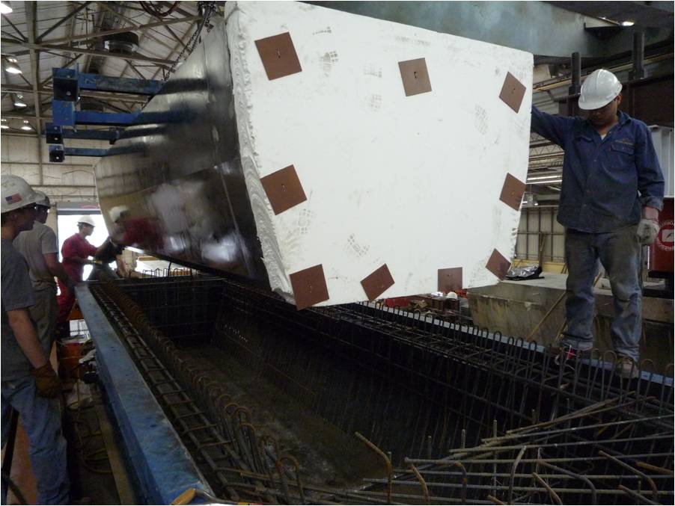
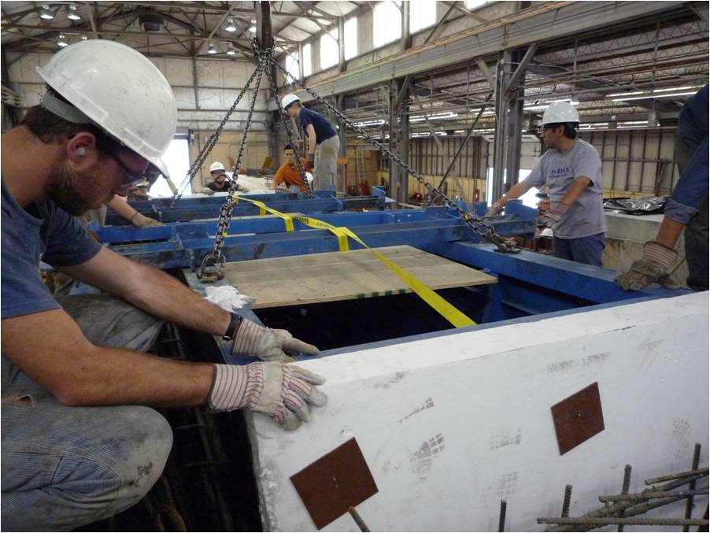
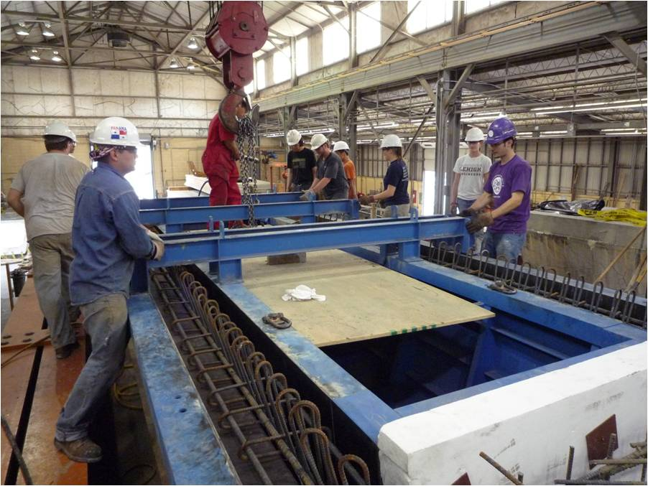
Fabrication Process
Beam 1
void placement during casting,
February 26, 2009

Slide 14
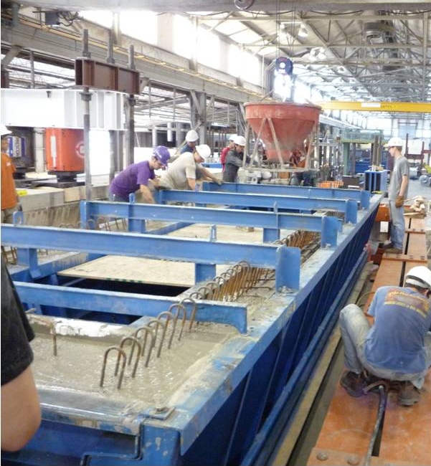

Release Schedule
A thermocouple was placed in the beam at the TxDOT release location and match-cured to SureCure cylinders
When concrete strength at that location was sufficient (f_{max} = 0.65 f_{ci}'), strands were released
For Beams 1 and 2, this occurred 17 to 18 hours
after batching

Slide 15
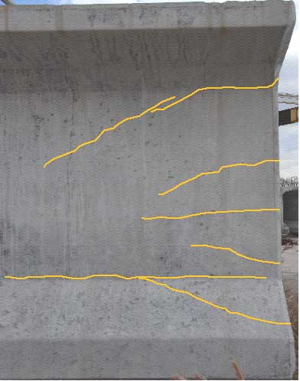
Observations at Release: Motivation
At release, prestressing forces cause cracking in the end region
Spalling caused by strain incompatibility, with beam sections trying to separate from each other
Bursting caused by transfer of large prestressing force into surrounding concrete
End region cracks highlighted in modified Type VI beam

Slide 16
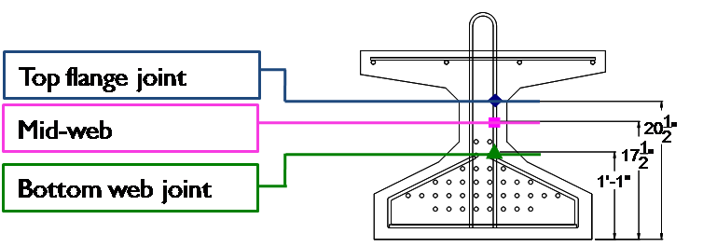
Observations at Release: Requirements
Bursting force that must be resisted by reinforcing is defined by AASHTO as 4% F_{P/S}
Bursting forces must be resisted by steel in end region
  AASHTO limits: stress in bars to 20 ksi,
  location of bars to h/4 (13.5 in.) from beam face
  PCI recommends: stresses less than 30 ksi,
  location of bars within h/5 (10.8 in.)
Previous UT-Austin study of Tx girders recorded higher strains in bars, and bars further into the beam carrying significant loads
  20 to 30 ksi
  h/2 into beam

Slide 17
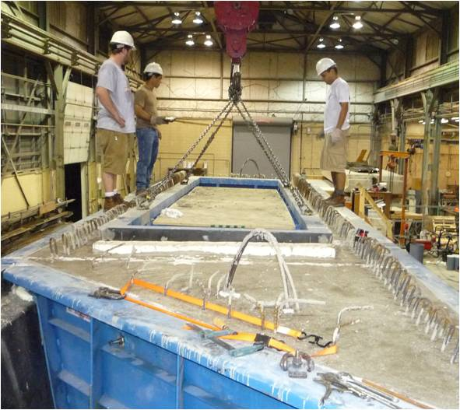
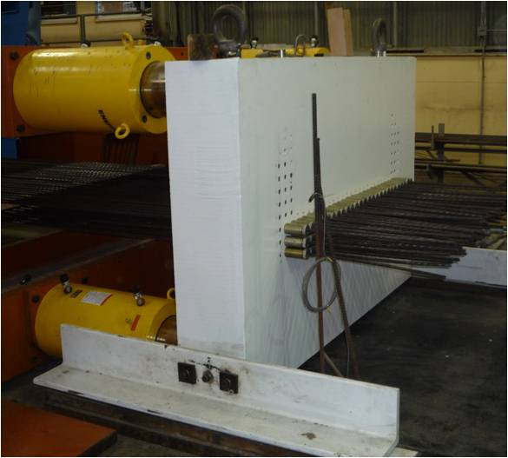
Observations at Release: Overview
78-0.5 in. diameter prestressing strands
  2.4 million pounds prestressing force
  F_{bursting} = 96 kip
  A_{bursting} = 4.8 in²
Reinforcing bars in both ends of Beams 1 and 2 were monitored to learn more about the distribution of bursting forces in U-beams

Slide 18
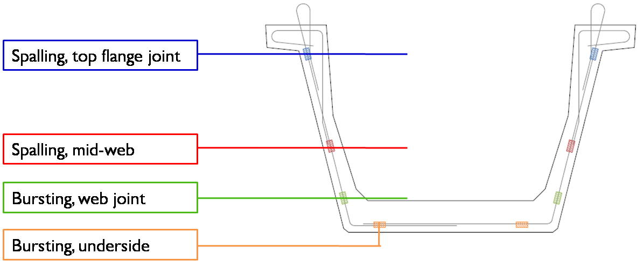
Observations at Release
U-beam instrumentation plan was similar to Tx girders
Underside gauging included to capture second transverse direction stresses

Slide 19
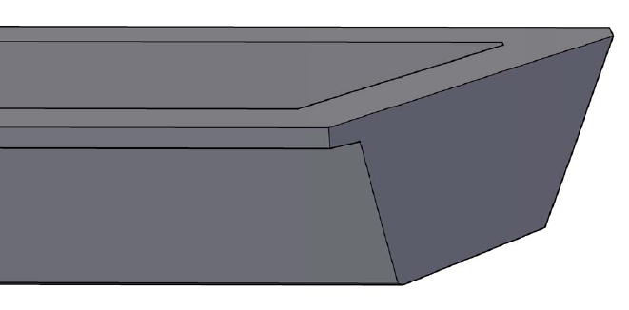
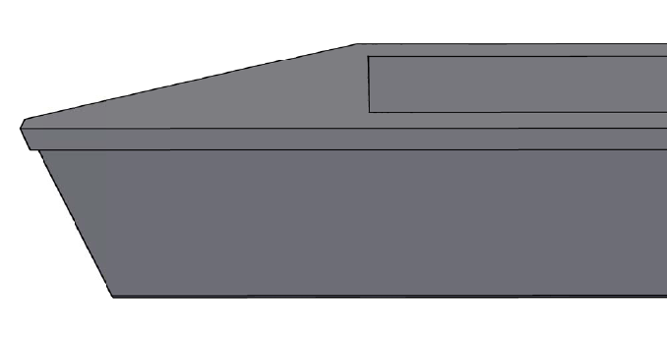
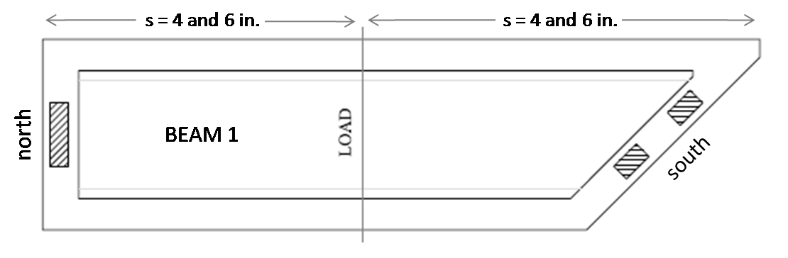
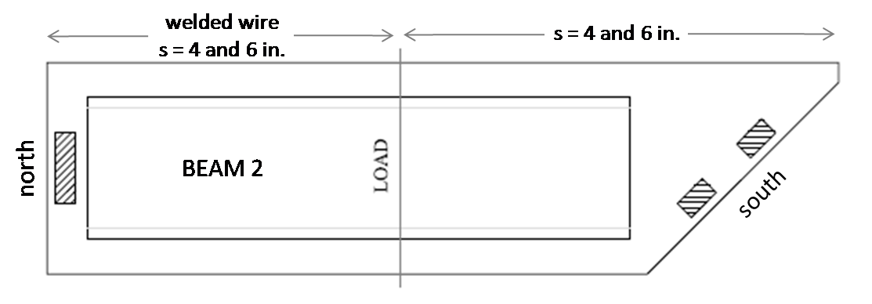
Summary of Release Observations
 | Beam 1 | Beam 2
Typical Stresses and Location | < 15 ksi, maximums at 3in. | < 20 ksi, maximums at 10 in.
Maximum Stresses and Location | 29 ksi, at 4 in. | 32 ksi, at 13 in.
Typical Bursting / Spalling Crack Widths Measured
Maximum Bursting / Spalling Crack Width Measured
Beam 1
Beam 2

Slide 20
Summary of Release Observations
 | Beam 1 | Beam 2
Typical Stresses and Location | < 15 ksi, maximums at 3in. | < 20 ksi, maximums at 10 in.
Maximum Stresses and Location | 29 ksi, at 4 in. | 32 ksi, at 13 in.
Typical Bursting / Spalling Crack Widths Measured | Hairline | Hairline
Maximum Bursting / Spalling Crack Width Measured | < 0.007 in. | < 0.007 in.

Slide 21
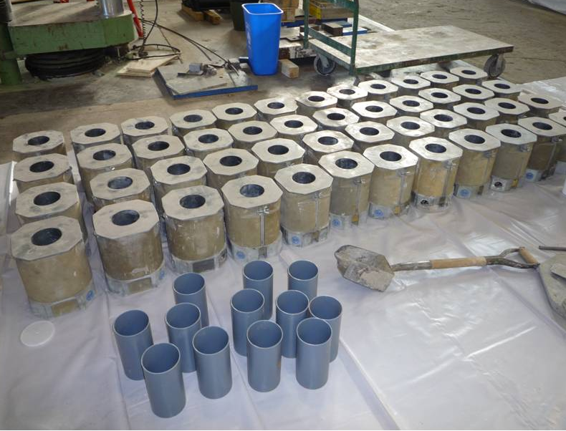
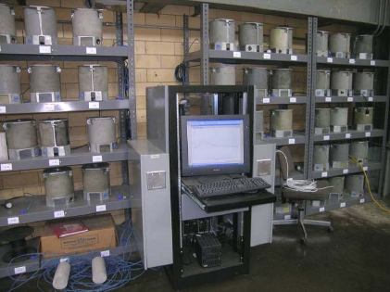
Temperature Monitoring
During cast and release, 22 thermocouple locations were monitored
  Of those, four were match-cured to cylinders in the SureCure system
Goals of temperature monitoring:
  Appropriately match-cure a cylinder for release, per TxDOT standards
  Determine maximum temperature in each end block
  Profile temperature distribution through a section of each end block

Slide 22
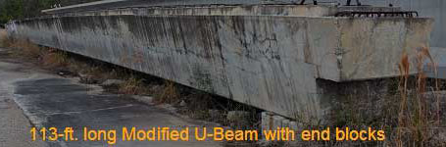

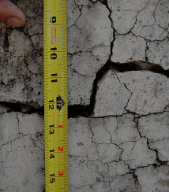
Temperature Monitoring: Motivation
ASR: Alkali-Silica Reaction
  Occurs when siliceous aggregate and high-alkali pore water form a gel that expands over time, creating cracks.
DEF: Delayed Ettringite Formation
  Occurs when ettringite is further hydrated after the concrete has set, expanding and creating cracks. Worsens with high curing temperatures.
Midspan cracking
(hairline)
ASR damage
End block cracking
ASR/DEF damage
Example of severe ASR/DEF damage through the length of a Texas trapezoidal beam (14 years old)

Slide 23
TxDOT Temperature Limits
Limit = 170° F with fly ash replacement
TxDOT Limits
150°F max temperature in beams with a straight cement mix (2004 TxDOT Standard Specification 424.3.7)
35°F temperature differential within mass concrete (e.g., endblock) (2004 TxDOT Standard Specification 420.4.14)
Mass concrete: minimum dimension in any direction = 5 ft

Slide 24
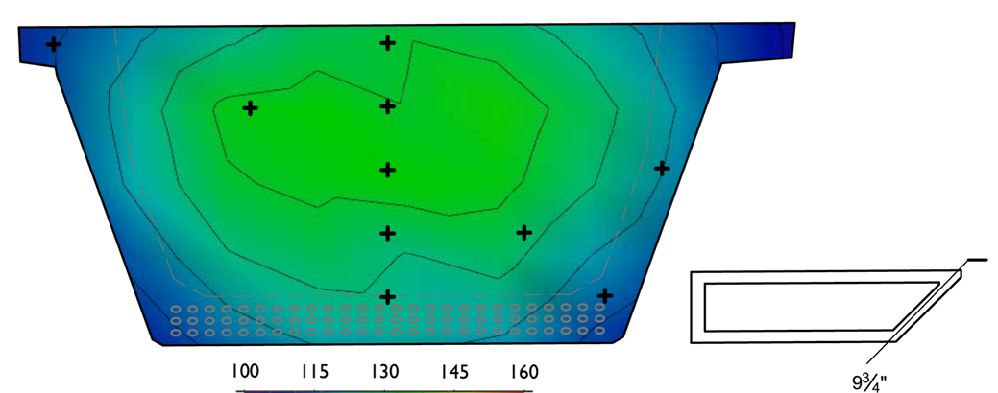
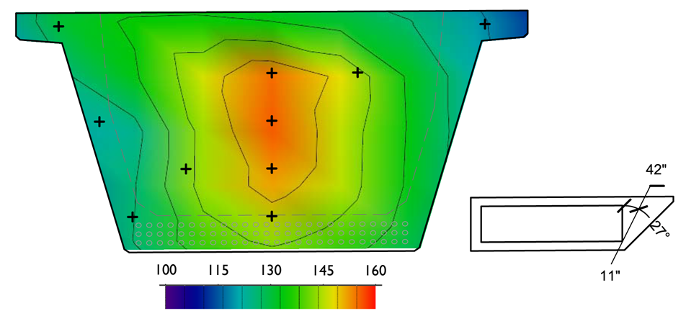
Observed Temperature Profiles:
At Release / Maximum (TxDOT: 150°F)
Beam 1:
 | Release: | 137° F
 | Maximum: | 139° F
 | Time: | +17 hrs
 | Ambient: | 75-85° F
Beam 2:
 | Release: | 156° F
 | Maximum: | 160° F
 | Time: | +18 hrs
 | Ambient: | 75-85° F
Time of batching = 0 hrs
Both beams have straight cement mix design

Slide 25
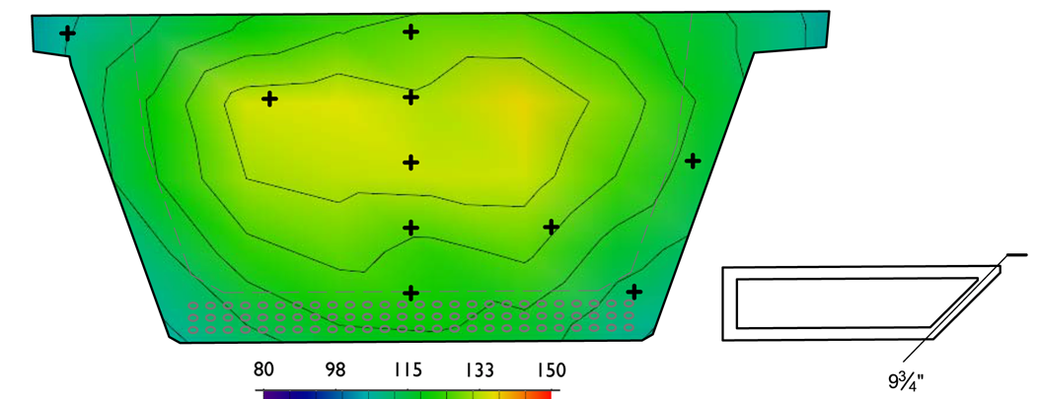
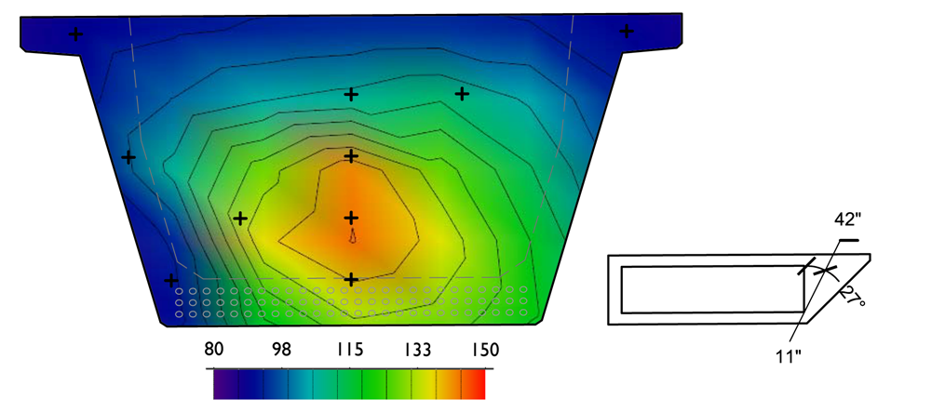
Observed Temperature Profiles:
Maximum Differential (TxDOT: 35°F)
Skewed 45° end block:
 | Maximum: | 137° F
 | Minimum: | 106° F
 | Ambient: | 73° F
 | Differential: | 31° F
 | Time: | +25 hrs
Solid 45° end block:
 | Maximum: | 144° F
 | Minimum: | 89° F
 | Ambient: | 83° F
 | Differential: | 55° F
 | Time: | +10 hrs
Time of batching = 0 hrs
Both beams have straight cement mix design

Slide 26
TxDOT Temperature Limits
TxDOT Limits | Beam 1: Big Endblock | Beam 2: Small Endblock | Δ
150°F max temperature in beams with a straight cement mix | 160 °F | 139°F | -21°F
35°F temperature differential within mass concrete (e.g., endblock) | 55°F | 31°F | -24°F
Both over limit
Both OK

Slide 27
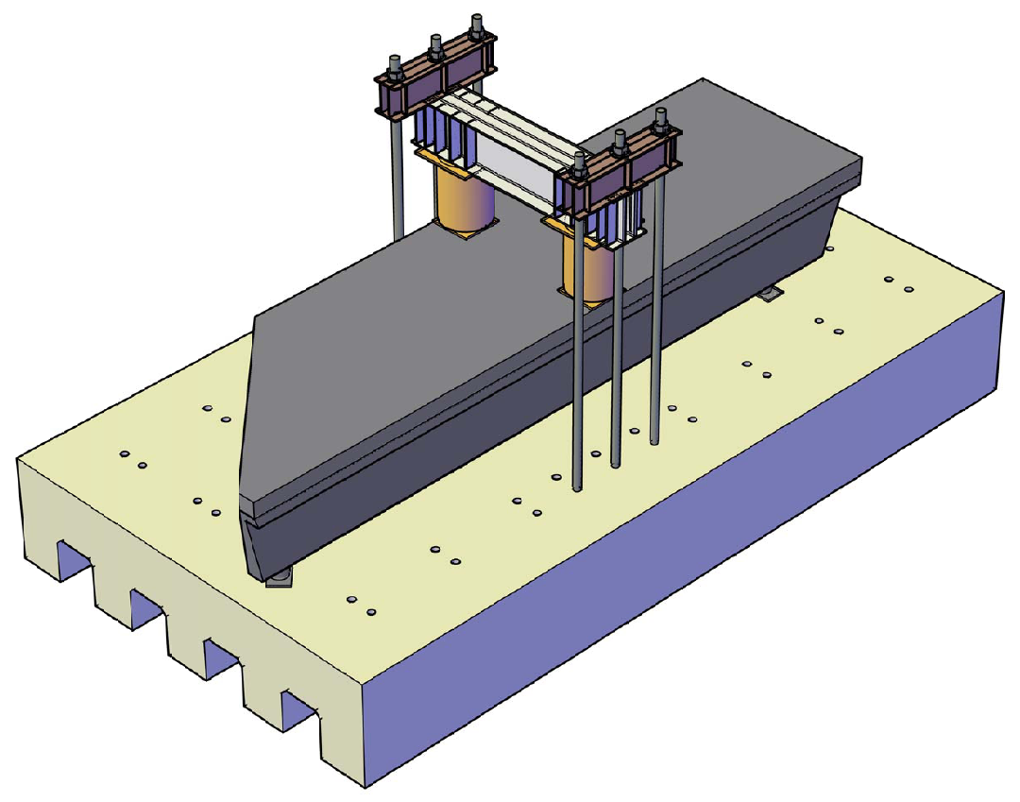
Shear Load Testing

Slide 28
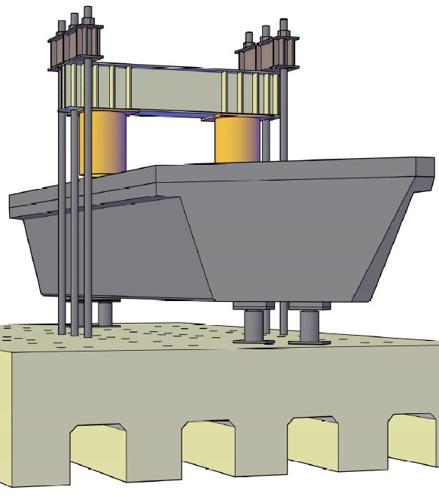
Shear Load Testing
Two bearing pads under skewed end

Slide 29
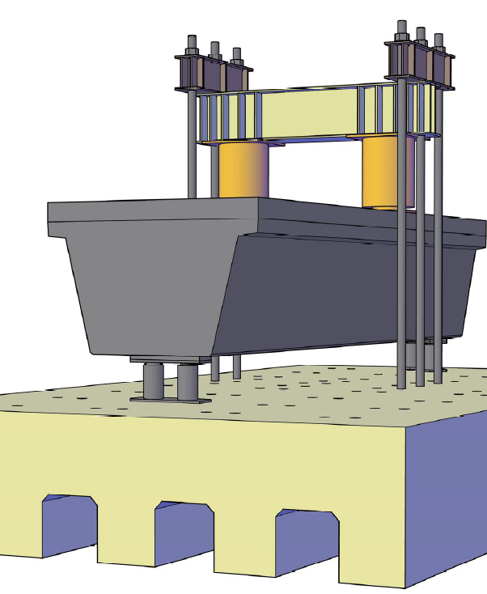
Shear Load Testing
Single bearing pad under straight end

Slide 30
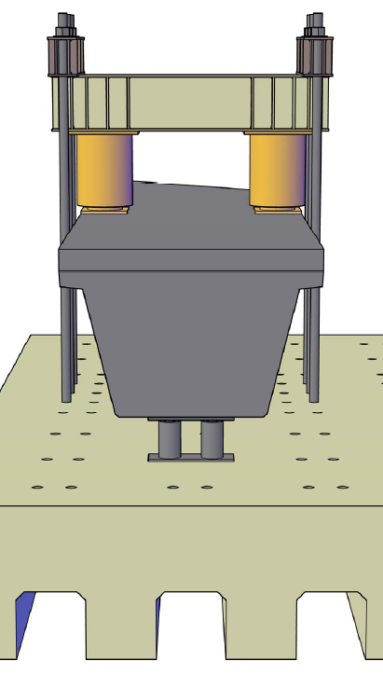
Shear Load Testing
Two hydraulic rams, each with 2M lb capacity
Reaction frame and strong floor, designed for 4M lb applied load

Slide 31
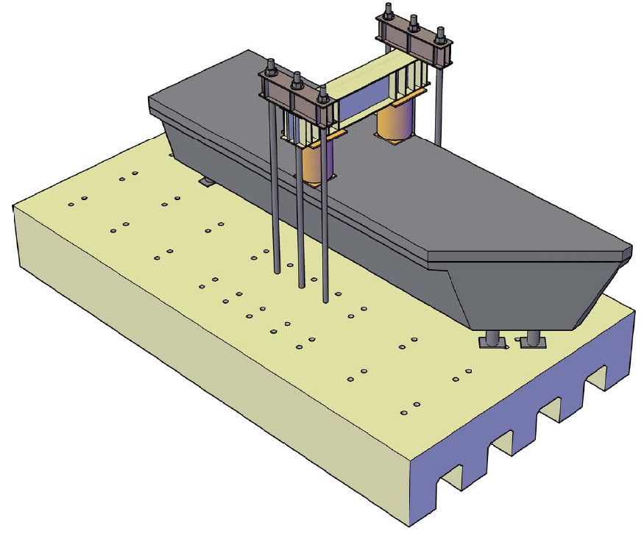
Shear Load Testing
Two test regions for shear capacity
(north and south)
1
2
NORTH
SOUTH

Slide 32
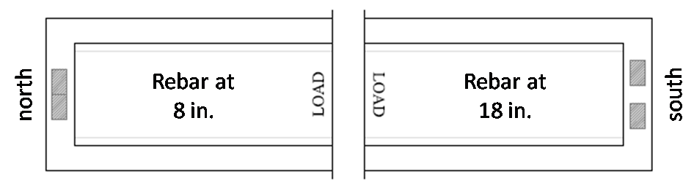
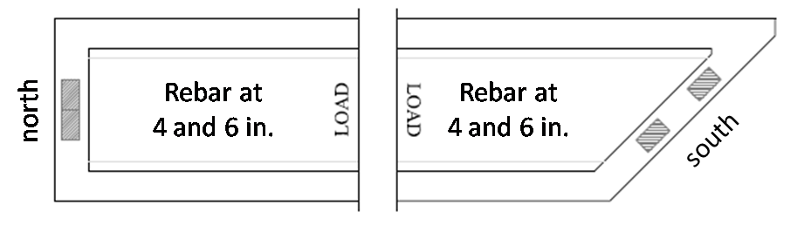
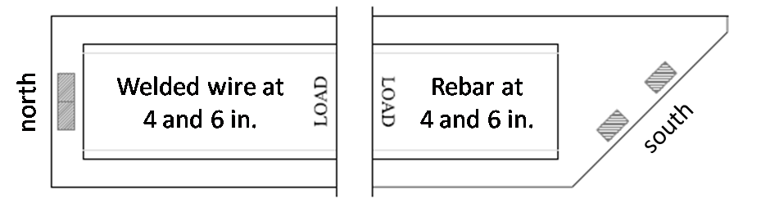
Shear Load Testing: Summary
Beam 0
  Two square ends,
  s = 8 in., 18 in.
  Single test
Beam 1
  One square end,
  one end skewed at 45°,
  internal void skewed
  Two tests
Beam 2
  One square end,
  one end skewed at 45°,
  internal void square,
  square end built with
  welded wire mesh
  Single test
Test 0S
Test 1N
Test 1S
Test 2N

Slide 33
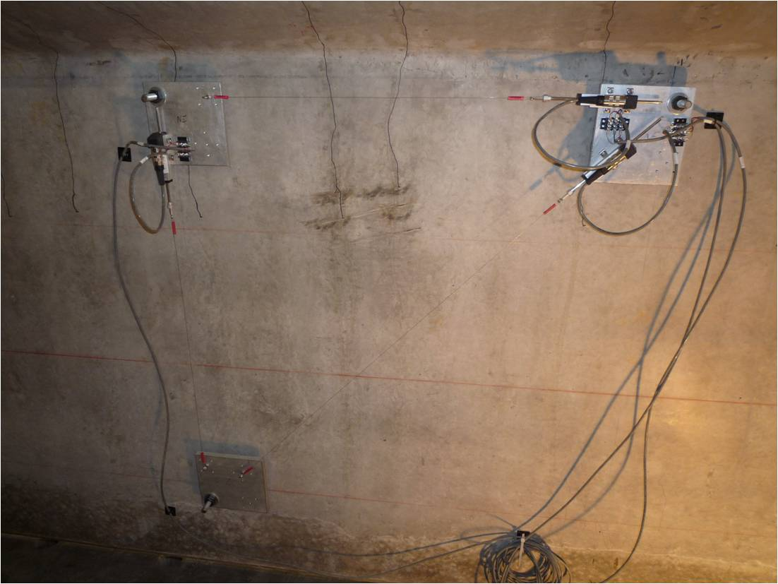

Shear Load Testing: Data Acquisition
Internal instrumentation:
  All strain gauges on reinforcing bars and strands were monitored during shear load testing
External instrumentation:
  Deflection
  Applied load
  Reaction forces
  Shear deformation
  Strand slip
Shear Deformation
South (skewed)
Location of strands monitored for slip

Slide 34
Shear Load Testing: Calculations
shear strength
contribution from concrete
contribution from stirrups
ACI |  | Simple
 |  | Detailed
AASHTO LRFD |  | General
 |  | Simplified
 |  | Segmental

Slide 35
Shear Load Testing: Calculations
 |  | V_{concrete} | V_{steel}
ACI | Simple |  | (45° truss model)
 | Detailed
AASHTO LRFD | General
 | Simplified
 | Segmental
All f_{c}' values in psi

Slide 36
Shear Load Testing: Calculations
Given:
  Concrete compressive strength
  Rebar yield strength
  Spacing and area of shear
  reinforcing bars
  Prestressing force
Measured during testing:
  Shear load on section at failure
Calculate , compare to 1.0
}

Slide 37




Shear Capacity
Beam 0
Beam 1
Beam 2

Slide 38



Upcoming Project Tasks
Construction and testing of Beam 3
  All rebar design
  Parallel 20° skewed ends, one large end block, one small
  Concrete mix to include 25% fly ash replacement
Design, construction, and testing of Beam 4
Box beam construction and testing
… Alejandro?

Slide 39

Questions or Comments?

Slide 40

Split-Web Model
Is it appropriate to think of each web as its own beam?

Slide 41

Split-Web Model
Is it appropriate to think of each web as its own beam?

Slide 42

Split-Web Model
Is it appropriate to think of each web as its own beam?

Slide 43

Web Load Ratios
NE = 1.07SE
NW = 0.90SW

Slide 44

Web Load Ratios
NE = 1.07SE
NW = 0.90SW

Slide 45


Web Load Ratios
NE = 1.07SE
NW = 0.90SW

